Slide 1
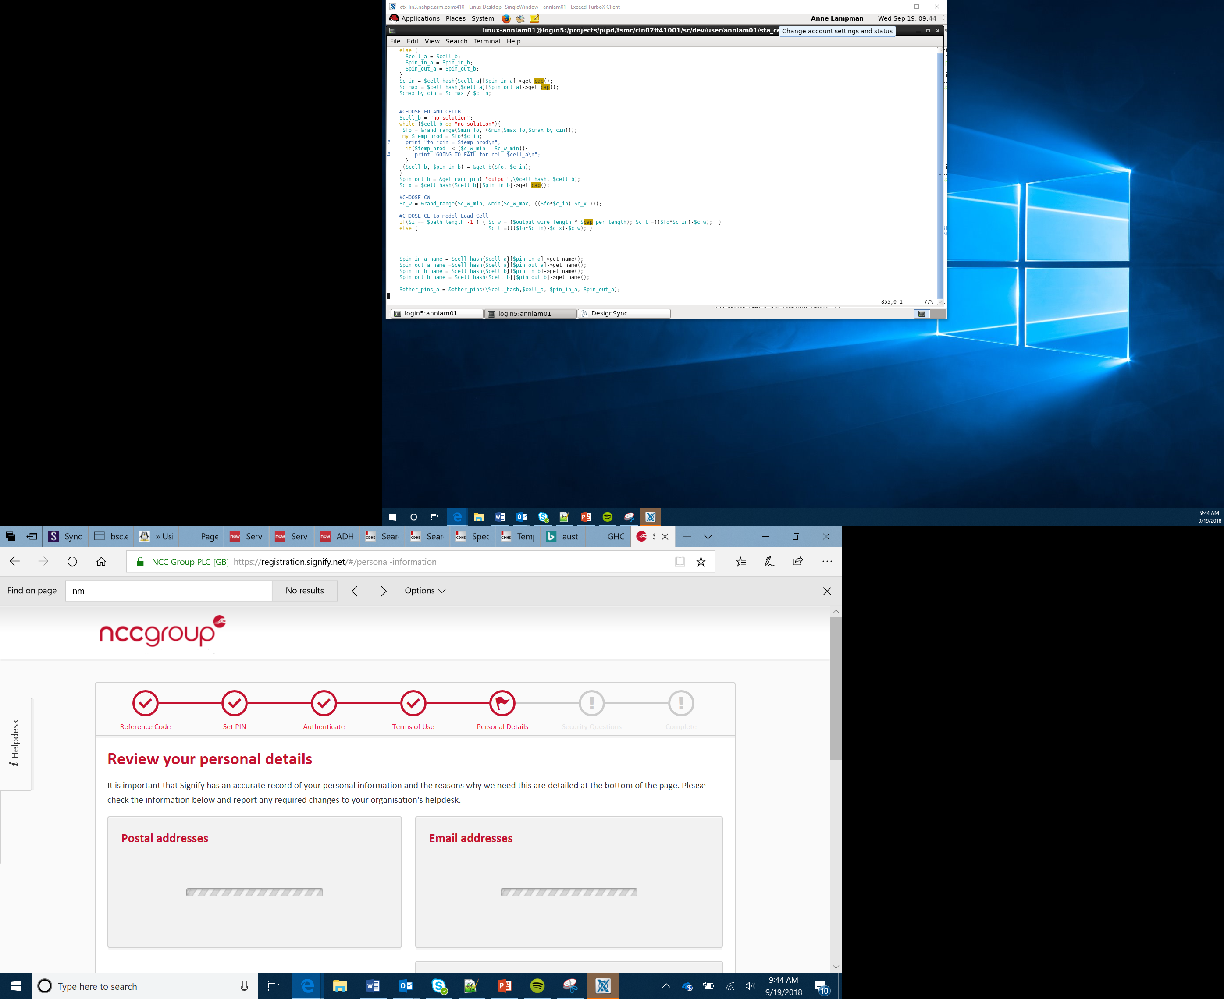
micro:pet
V2

Slide 2
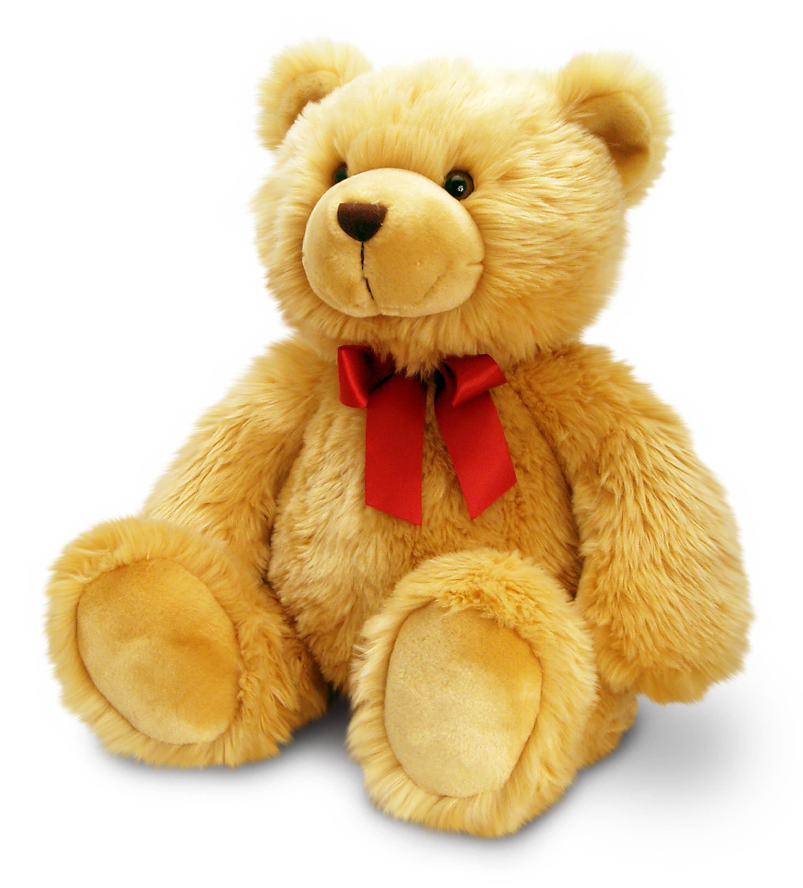
Setting the scene
Loneliness and isolation are a real problem for children and the elderly staying in hospitals for long periods of time, especially in rural areas.
You have been tasked with creating a digital pet that can be played with and that can keep people company whilst they stay in hospital.
The pet must be interactive.
Notes:
Ask the learners how they would interact with a micro:pet
What would they expect it to do?
How would it react to different inputs?

Slide 3
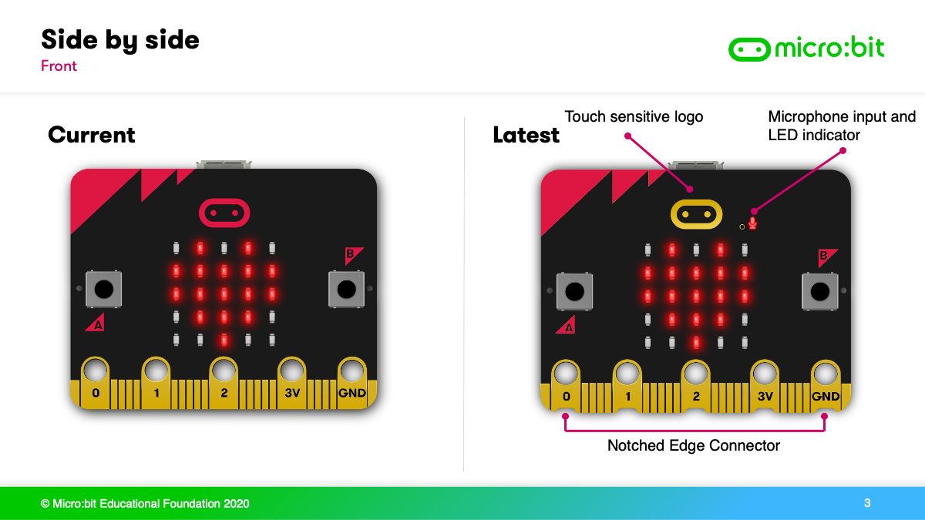
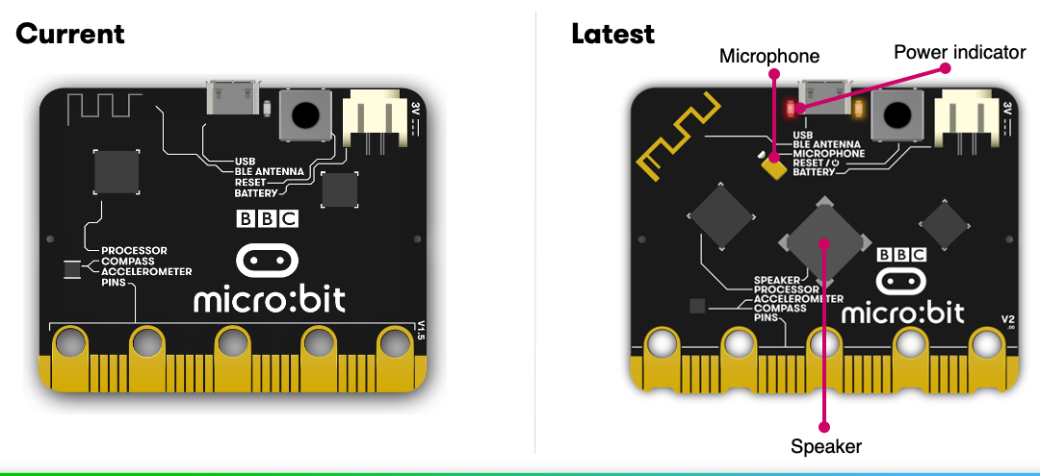
The micro:bit v2
Notes:
Briefly describe the micro:bit
Ask the learners what are the inputs and outputs?

Slide 4
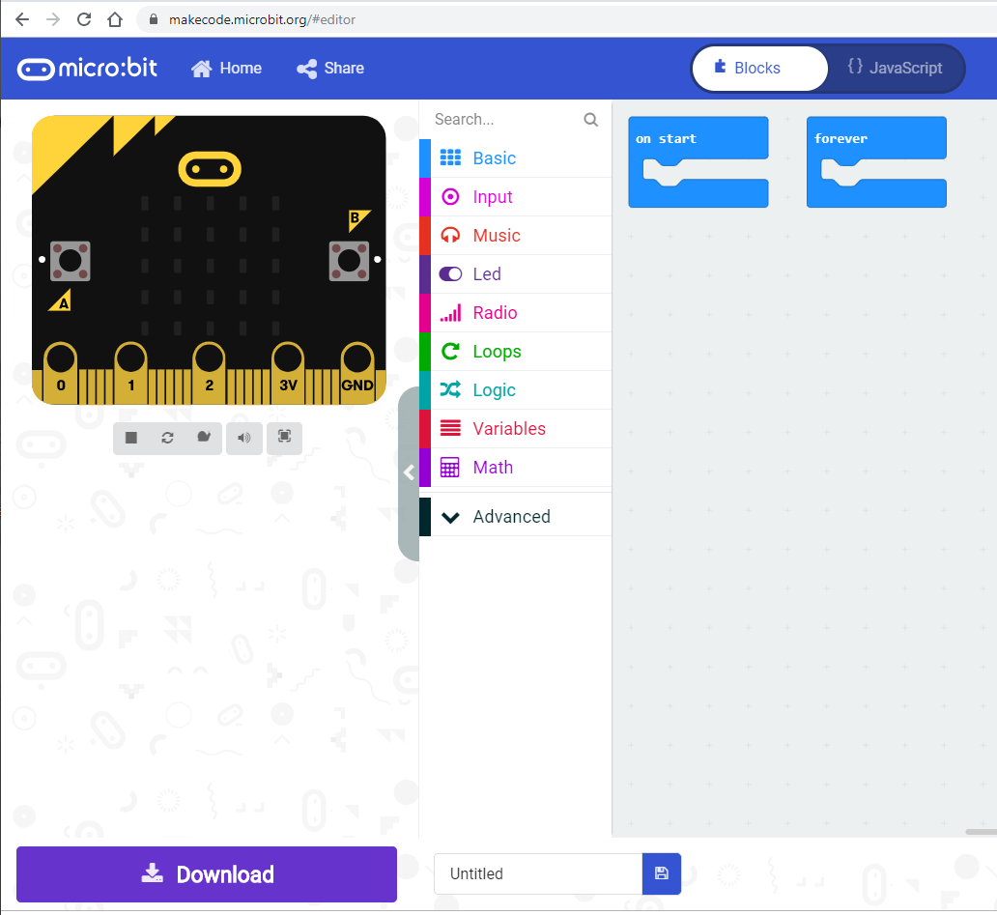
makecode
https://makecode.microbit.org/
Make a program
Give it a name
Hit download
Copy/paste onto micro:bit
Notes:
Ask the learners if they have used Scratch before – makecode is very similar to Scratch but has more tools for the micro:bit
If the majority of learners have used micro:bit them move on, if not then demo the process of getting code onto the micro:bit
Create a happy face (see cheat sheet) using the blocks
Go through the process of getting the code onto the micro:bit

Slide 5
The challenge
Teams of 2-3 or on your own!
Each team member needs to take responsibility for a task
Manage your time wisely!
Stimulus cards available if needed
Your team must:
Name your micro:pet
Make a micro:pet
Program the interactivity for your pet
Give a brief ‘elevator pitch’ to sell your product
Notes:
This activity can be done individually or in teams, the key is to ensure everyone is included.

Slide 6
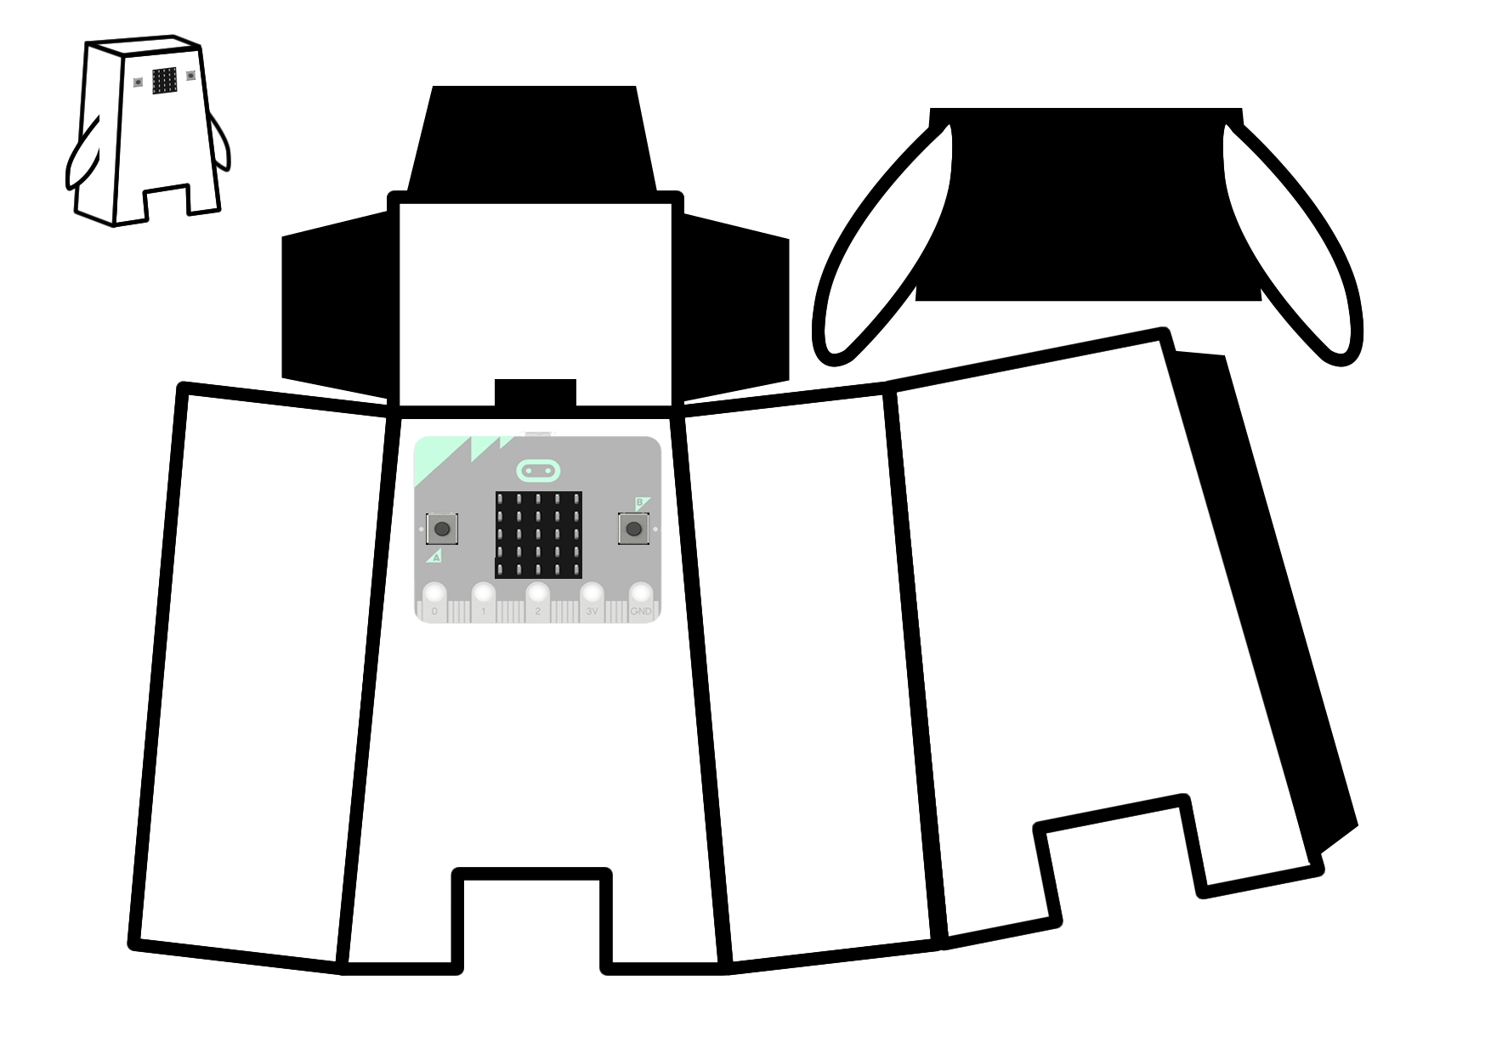
The net
The net is a 2D representation of a 3D model
The black bits are tabs (to be glued/taped)
Feel free to adapt the net
Be creative!
You can make more than one
Notes:
Ensure they understand what the net is for. They can adapt the net or make their own. The ide is they attach the micro:bit inside the pet.

Slide 7
micro:pet features
Reacting to playing/shaking (accelerometer)
Emotions that are effected by interaction or noise
Feeding (every few seconds/minutes)
Needing attention (gets lonely if not interacted with frequently) and tells you!
Sleeping and waking (light sensor) - think snoring
Reacting to temperature (temperature sensor)
Communication/interaction between micro:pets (advanced)
Use the new speaker and mic to make your pet come alive
Notes:
Go through a few ideas of what the interactions could be, these are also on the cheat sheets if needed.

Slide 8
Success criteria
The product must be suitable for one of the users listed below and the pet must:
Look like a friendly pet (be creative)
Be robust enough to be played with
Contain a micro:bit that users can interact with
Have a face to express emotions when interacted with
Have one or more interactions programmed so it behaves like a pet to keep the user company
Use the speaker/mic to make your pet talk and react to touch
Notes:
This is what they need to achieve. Leave this displayed once they get started as a reminder.

Slide 9
Wrap up
What was this all about?
Creative problem solving – STEM

